Slide 1
Beyond A1c: Exploring the Expanding Role of Anti-Diabetic Agents
Saidee Oberlander, PharmD, BCPS
Acute Care Pharmacist – Essentia Health Fargo

Slide 2
Disclosures
The presenter has nothing to disclose concerning possible financial or personal relationships with commercial entities (or their competitors) that may be referenced in this presentation.

Slide 3
Objectives
Review current guidance regarding use of anti-diabetic agents
Understand current data regarding use of anti-diabetic agents and explore potential applications to clinical practice
Identify strategies to optimize pharmaceutical treatment for patients with and without diabetes and various comorbidities

Slide 4
Introduction
In 2018, 34.2 million people in the US had diabetes¹
10.5% of population
13% of all US adults
Elevated risk for cardiovascular disease, chronic kidney disease, obesity, and other health conditions²
Medications developed for diabetes also show benefits for these conditions

Slide 5
Diabetes Treatment Timeline³

Slide 6
Cardiovascular Benefits

Slide 7
Cardiovascular Benefits
Diabetes is an independent risk factor for development of atherosclerotic cardiovascular disease (ASCVD)⁴
Hospitalization risk for heart failure (HF) exacerbations is two-fold higher in patients with diabetes⁵
68.4% of patients with diabetes in the US had hypertension¹
43.5% of patients had non-HDL cholesterol ≥ 130 mg/dL¹

Slide 8
FDA Guidance
2008: FDA issues guidance for evaluating cardiovascular incomes in new antidiabetic therapies⁶
Response to concern for worsening cardiovascular outcomes with other diabetic agents
All anti-diabetic medications must demonstrate cardiovascular safety before submission to the FDA

Slide 9
ASCVD Risk
Notes:
https://www.cdc.gov/diabetes/pdfs/data/statistics/national-diabetes-statistics-report.pdf

Slide 10
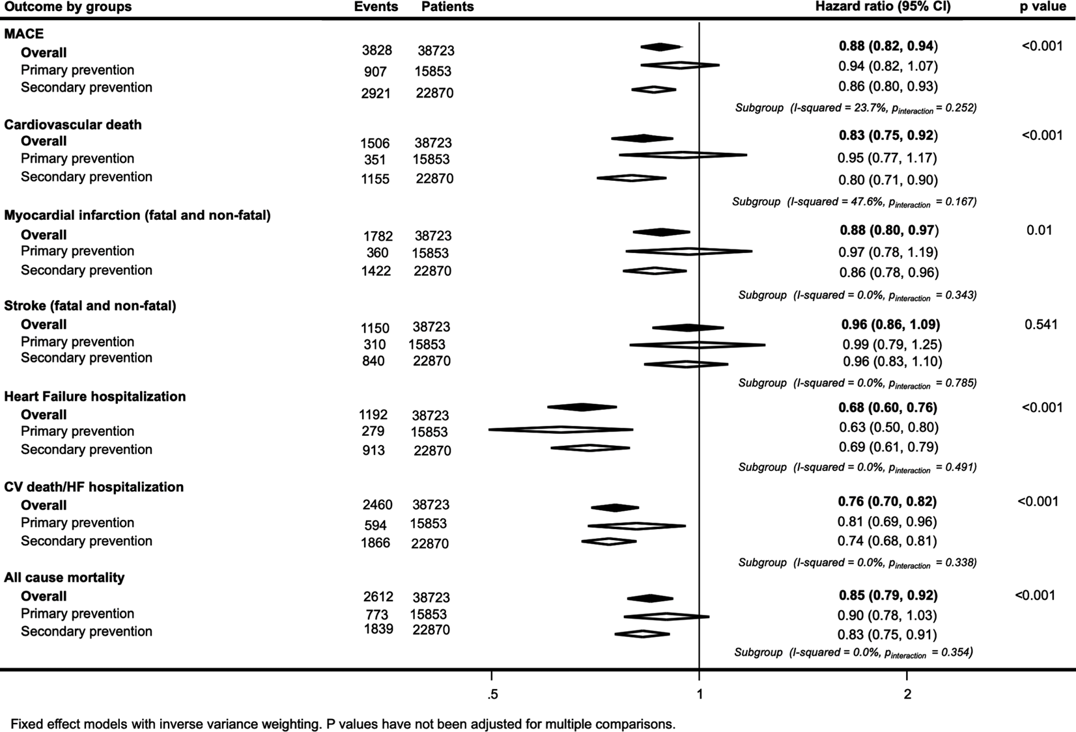
SGLT-2 Inhibitors
Statistically significant reduction in cardiovascular events seen with empagliflozin, dapagliflozin, canagliflozin⁷
Meta analysis of CANVAS, CREDENCE, DECLARE-TIMI, and EMPA-REG trials⁸
Effect on CV outcomes in patients with T2DM
Overall benefit for major cardiac events
0.88; 95% CI, 0.82–0.94; P<0.001
Benefits also seen for HF hospitalization, CV death, and death from any cause

Slide 11
SGLT2 Trials⁷
 | EMPA-REG OUTCOME (8) (n = 7,020) | CANVAS Program (9) (n = 10,142) | DECLARE-TIMI 58 (189) (n = 17,160)
Intervention | Empagliflozin/placebo | Canagliflozin/placebo | Dapagliflozin/placebo
Main inclusion criteria | Type 2 diabetes and preexisting CVD | Type 2 diabetes and preexisting CVD at ≥30 years of age or >2 CV risk factors at ≥50 years of age | Type 2 diabetes and established ASCVD or multiple risk factors for ASCVD
Median follow-up (years) | 3.1 | 3.6 | 4.2
Year started/reported | 2010/2015 | 2009/2017 | 2013/2018
Primary outcome§ | 3-point MACE 0.86 (0.74–0.99) | 3-point MACE 0.86 (0.75–0.97) | 3-point MACE 0.93 (0.84–1.03)
Key secondary outcome§ | 4-point MACE 0.89 (0.78–1.01) | All-cause and CV mortality (see below) | Death from any cause 0.93 (0.82–1.04)
 | CV death or HF hospitalization 0.71 (0.55–0.92) | CV death 0.92 (0.77–1.11)
 | Death from any cause 0.69 (0.53–0.88)
Cardiovascular death§ | 0.62 (0.49–0.77) | 0.87 (0.72–1.06) | 0.98 (0.82–1.17)
MI§ | 0.87 (0.70–1.09) | 0.89 (0.73–1.09) | 0.89 (0.77–1.01)
Stroke§ | 1.18 (0.89–1.56) | 0.87 (0.69–1.09) | 1.01 (0.84–1.21)
HF hospitalization§ | 0.65 (0.50–0.85) | 0.67 (0.52–0.87) | 0.73 (0.61–0.88)
Unstable angina hospitalization§ | 0.99 (0.74–1.34) | — | —
All-cause mortality§ | 0.68 (0.57–0.82) | 0.87 (0.74–1.01) | 0.93 (0.82–1.04)

Slide 12
SGLT2 Dosing for CV Benefit⁴
Canagliflozin
100 mg daily
eGFR 30 to 59 ml/min/1.73 m²: Max dose 100 mg daily
eGFR <30 ml/min/1.73 m²: Use is not recommended
Dapagliflozin
10 mg daily
eGFR <45 ml/min/1.73 m²: Use is not recommended f
eGFR <30 mL/min/1.73 m²: use is contraindicated.
Empagliflozin
10 mg daily
eGFR <45 mL/min/1.73 m²: use is not recommended
Notes:
https://www.jacc.org/doi/10.1016/j.jacc.2020.05.037

Slide 13
GLP-1 Inhibitors
Statistically significant reduction in cardiovascular events with liraglutide, semaglutide, dulaglutide, and albiglutide (removed from market) with or without clinical ASCVD at baseline⁴

Slide 14
LEADER (2016)⁹
Liraglutide vs placebo
Primary outcome: composite of death from cardiovascular causes, nonfatal MI, and nonfatal stroke
Rate of primary outcome 13% with liraglutide vs 14.9% with placebo (hazard ratio, 0.78; 95% CI, 0.66 to 0.93)

Slide 15
GLP-1 Inhibitor Trials⁷
 | LEADER (194) (n = 9,340) | SUSTAIN-6 (195)* (n = 3,297) | REWIND (198) (n = 9,901)
Intervention | Liraglutide/placebo | Semaglutide s.c. injection/placebo | Dulaglutide/ placebo
Main inclusion criteria | Type 2 diabetes and preexisting CVD, CKD, or HF at ≥50 years of age or CV risk at ≥60 years of age | Type 2 diabetes and preexisting CVD, HF, or CKD at ≥50 years of age or CV risk at ≥60 years of age | Type 2 diabetes and prior ASCVD event or risk factors for ASCVD
Median follow-up (years) | 3.8 | 2.1 | 5.4
Prior CVD/CHF (%) | 81/18 | 60/24 | 32/9
Mean baseline A1C (%) | 8.7 | 8.7 | 7.4
Year started/reported | 2010/2016 | 2013/2016 | 2011/2019
Primary outcome | 3-point MACE 0.87 (0.78–0.97) | 3-point MACE 0.74 (0.58–0.95) | 3-point MACE 0.88 (0.79–0.99)
Key secondary outcome | Expanded MACE 0.88 (0.81–0.96) | Expanded MACE 0.74 (0.62–0.89) | Composite microvascular outcome (eye or renal outcome) 0.87 (0.79–0.95)
Cardiovascular death | 0.78 (0.66–0.93) | 0.98 (0.65–1.48) | 0.91 (0.78–1.06)
MI | 0.86 (0.73–1.00) | 0.74 (0.51–1.08) | 0.96 (0.79–1.15)
Stroke | 0.86 (0.71–1.06) | 0.61 (0.38–0.99) | 0.76 (0.61–0.95)
HF hospitalization | 0.87 (0.73–1.05) | 1.11 (0.77–1.61) | 0.93 (0.77–1.12)
Unstable angina hospitalization | 0.98 (0.76–1.26) | 0.82 (0.47–1.44) | 1.14 (0.84–1.54)
All-cause mortality | 0.85 (0.74–0.97) | 1.05 (0.74–1.50) | 0.90 (0.80–1.01)

Slide 16
GLP-1 Inhibitor Trials⁷
 | ELIXA (199) (n = 6,068) | EXSCEL (200) (n = 14,752) | PIONEER-6 (196) (n = 3,183)
Intervention | Lixisenatide/placebo | Exenatide QW/placebo | Semaglutide oral/placebo
Main inclusion criteria | Type 2 diabetes and history of ACS (<180 days) | Type 2 diabetes with or without preexisting CVD | Type 2 diabetes and high CV risk (age of ≥50 years with established CVD or CKD, or age of ≥60 years with CV risk factors only)
Median follow-up (years) | 2.1 | 3.2 | 1.3
Prior CVD/CHF (%) | 100/22 | 73.1/16.2 | 84.7/12.2
Mean baseline A1C (%) | 7.7 | 8.0 | 8.2
Year started/reported | 2010/2015 | 2010/2017 | 2017/2019
Primary outcome | 4-point MACE 1.02 (0.89–1.17) | 3-point MACE 0.91 (0.83–1.00) | 3-point MACE 0.79 (0.57–1.11)
Key secondary outcome | Expanded MACE 1.02 (0.90–1.11) | Individual components of MACE (see below) | Expanded MACE or HF hospitalization 0.82 (0.61–1.10)
Cardiovascular death | 0.98 (0.78–1.22) | 0.88 (0.76–1.02) | 0.49 (0.27–0.92)
MI | 1.03 (0.87–1.22) | 0.97 (0.85–1.10) | 1.18 (0.73–1.90)
Stroke | 1.12 (0.79–1.58) | 0.85 (0.70–1.03) | 0.74 (0.35–1.57)
HF hospitalization | 0.96 (0.75–1.23) | 0.94 (0.78–1.13) | 0.86 (0.48–1.55)
Unstable angina hospitalization | 1.11 (0.47–2.62) | 1.05 (0.94–1.18) | 1.56 (0.60–4.01)
All-cause mortality | 0.94 (0.78–1.13) | 0.86 (0.77–0.97) | 0.51 (0.31–0.84)

Slide 17
GLP-1 Dosing for CV Benefit⁴
Dulaglutide
Initial 0.75 mg/week
Max 1.5 mg/week
No renal or hepatic adjustment
Liraglutide
Initial 0.6 mg/day
Max 1.8 mg/day
No renal or hepatic adjustment
Semaglutide SC
Initial 0.25 mg/week
Max 1 mg/week
No renal or hepatic adjustment
Notes:
https://www.jacc.org/doi/10.1016/j.jacc.2020.05.037

Slide 18
DPP-4 Inhibitors
Dipeptidyl Peptidase 4 inhibitors have not demonstrated CV benefit vs placebo⁴

Slide 19
https://www.jacc.org/doi/10.1016/j.jacc.2020.05.037

Slide 20
https://www.jacc.org/doi/10.1016/j.jacc.2020.05.037
Notes:
https://www.jacc.org/doi/10.1016/j.jacc.2020.05.037

Slide 21
ADA Guidelines²

Slide 22
Heart Failure
Notes:
https://www.cdc.gov/diabetes/pdfs/data/statistics/national-diabetes-statistics-report.pdf

Slide 23
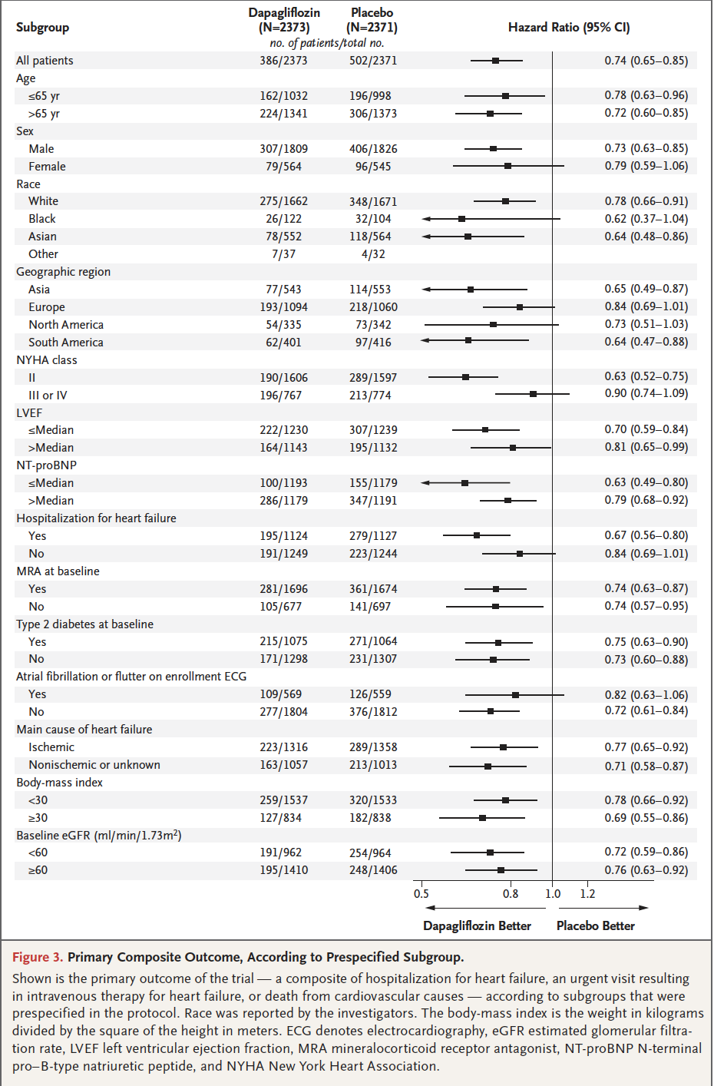
DAPA-HF (2019)¹⁰
Dapagliflozin vs Placebo in HF patients with and without T2DM
42% of patients with diabetes at baseline
Primary outcome: composite of worsening heart failure or death
Primary outcome occurred in 16.3% of the dapagliflozin vs 21.2% of placebo (hazard ratio, 0.74; 95% confidence interval [CI], 0.65 to 0.85)
Heart failure hospitalization reduced
hazard ratio, 0.75; 95% CI, 0.65 to 0.85
Notes:
DOI: 10.1056/NEJMoa1911303

Slide 24
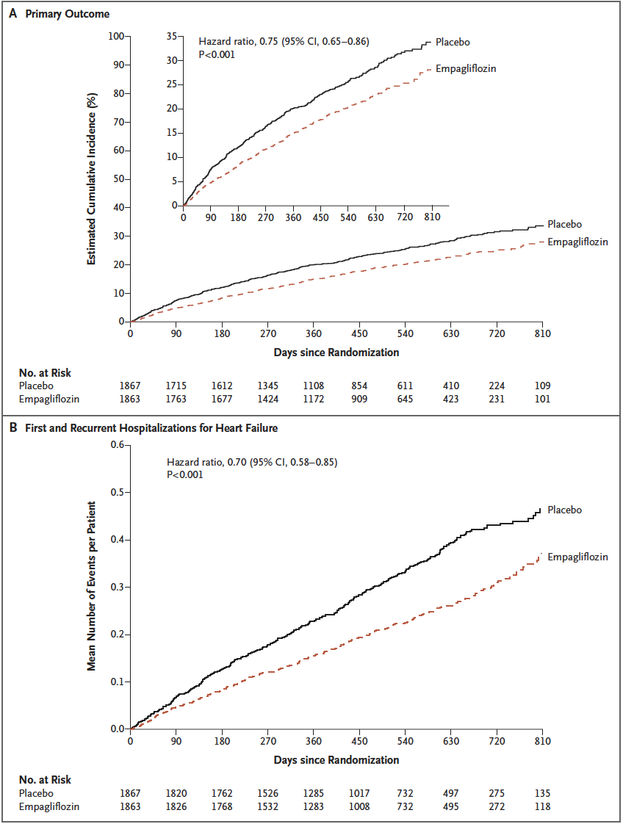
EMPEROR-REDUCED (2020)¹¹
Empagliflozin vs placebo in patients with HF with and without T2DM
Primary outcome: composite of cardiovascular death or death from any cause
Empagliflozin 19.4% and placebo 24.7% (HR 0.75; 95% confidence interval [CI], 0.65 to 0.86)
Heart Failure hospitalizations also reduced (hazard ratio, 0.70; 95% CI, 0.58 to 0.85)
Notes:
DOI: 10.1056/NEJMoa2022190

Slide 25
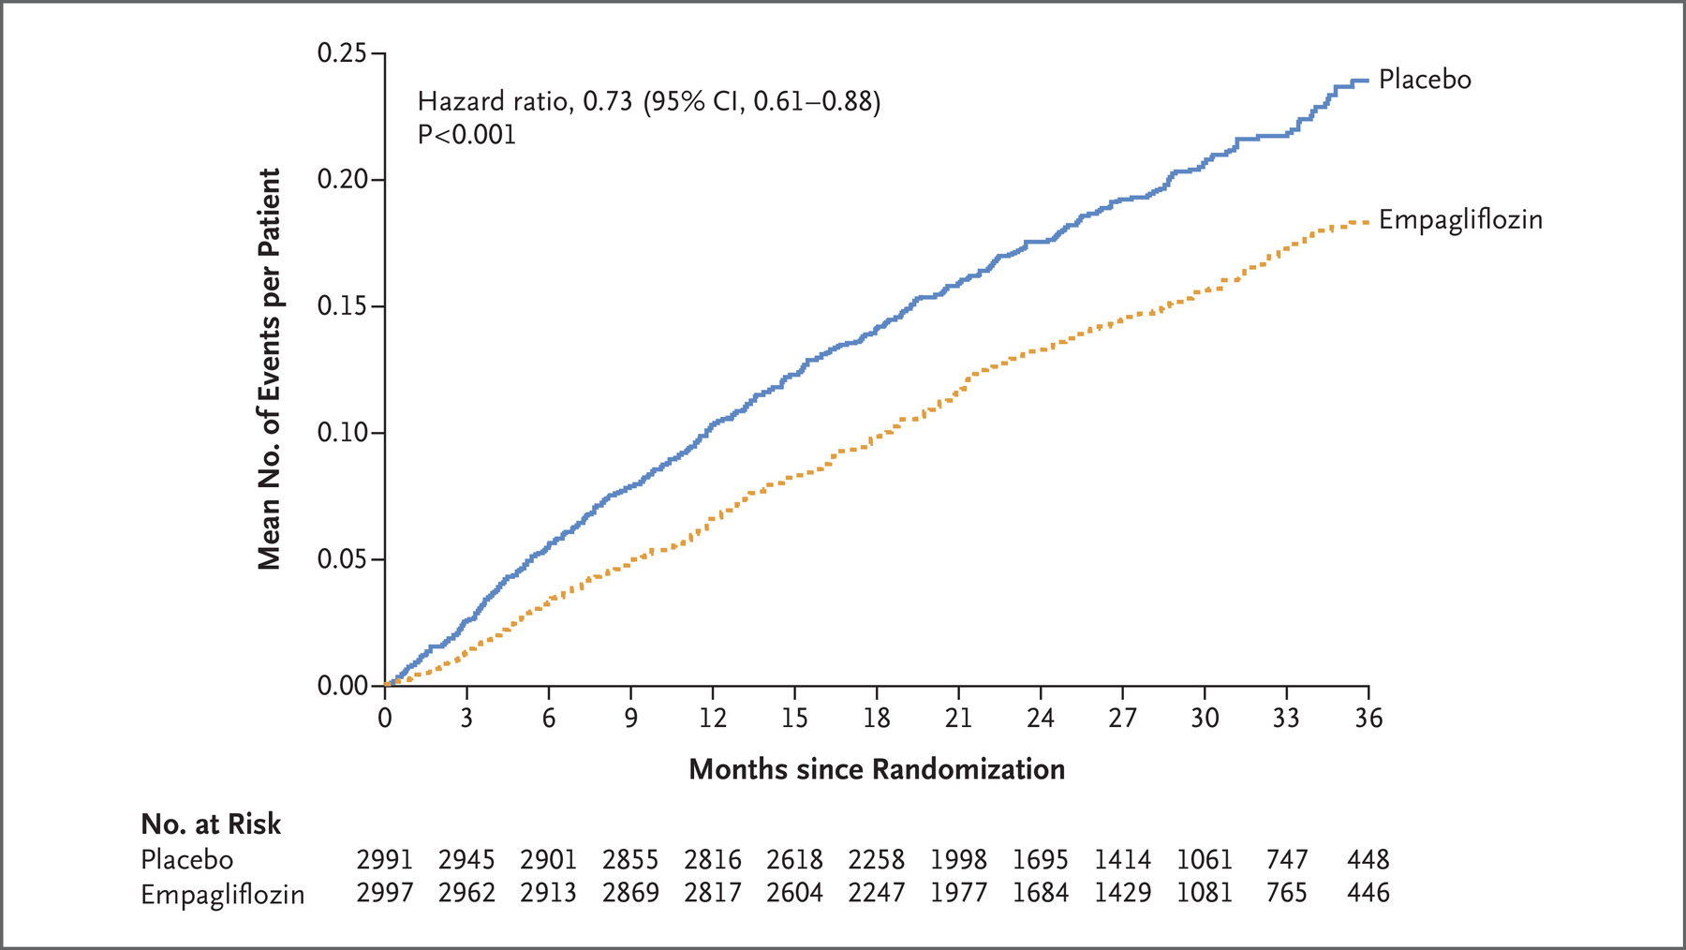
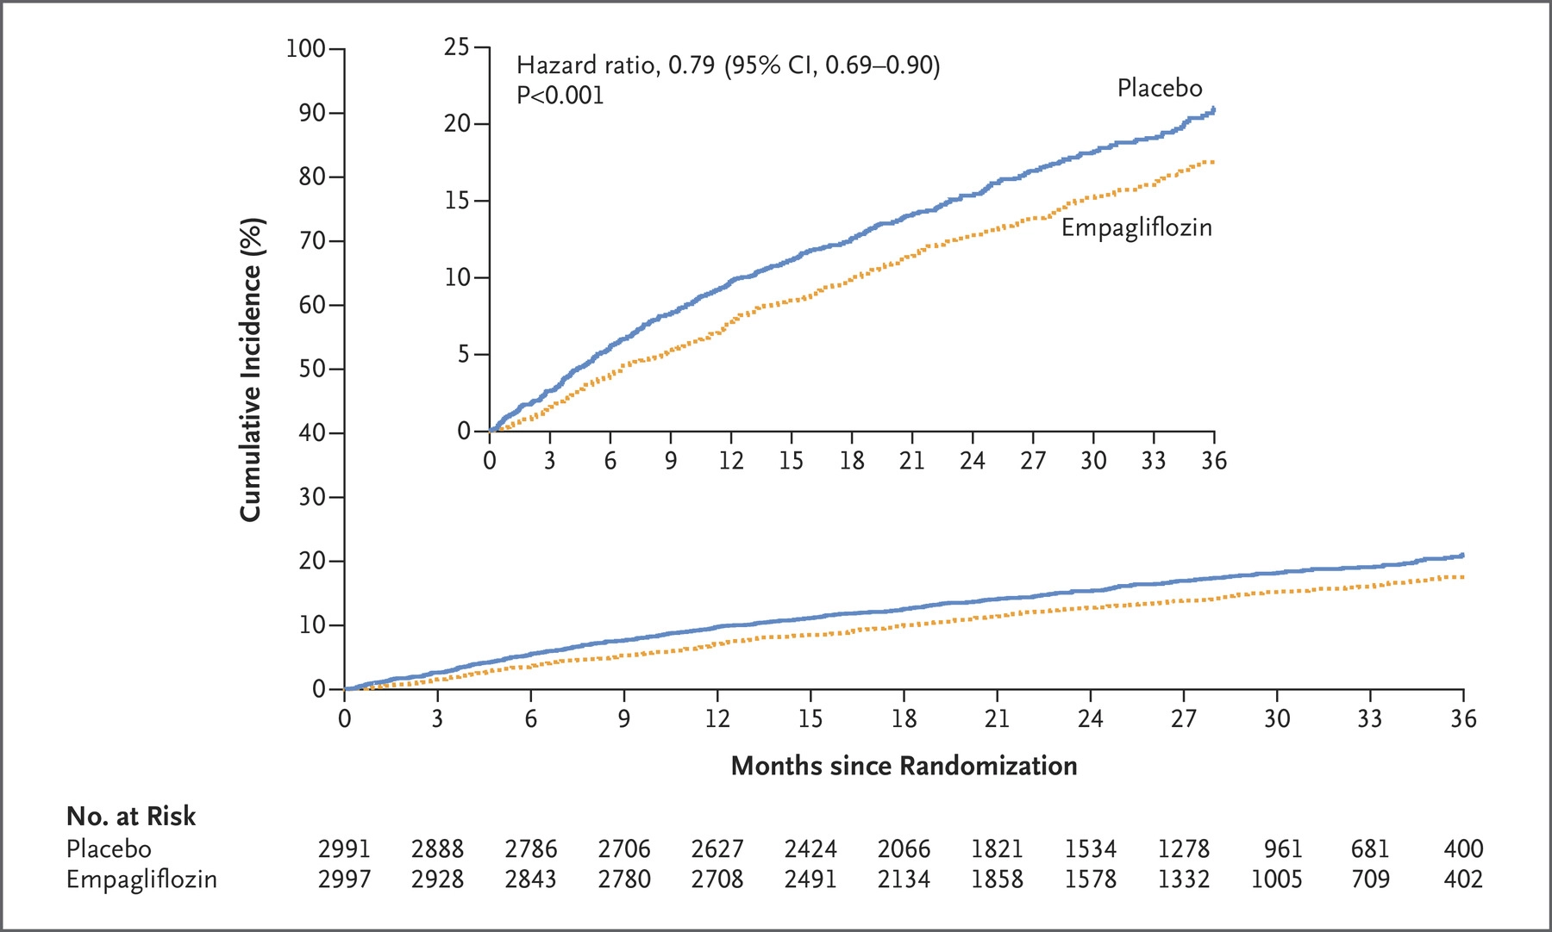
EMPEROR-PRESERVED (2021)¹²
Empagliflozin vs placebo in patients with heart failure with PRESERVED ejection fraction with and without diabetes
Median follow-up 26.2 months
Primary outcome: composite of cardiovascular death or hospitalization for heart failure
13.8% with empagliflozin vs 17.1% with placebo (hazard ratio, 0.79; 95% CI, 0.69 to 0.90)

Slide 26
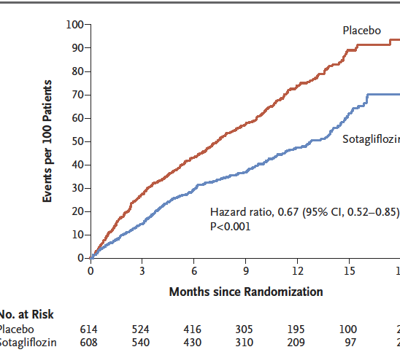
SOLOIST-WH (2021)13
Sotagliflozin vs placebo in patients with T2DM and recent hospitalization for heart failure (within past 3 days)
Primary outcome: deaths from cardiovascular causes and hospitalizations and urgent visits for heart failure
rate of primary end-point events was 51.0 per 100 patient-years in the sotagliflozin group and 76.3 per 100 patient-years in the placebo group (hazard ratio, 0.67; 95% confidence interval [CI], 0.52 to 0.85)
Trial ended early due to lack of funding
Notes:
DOI: 10.1056/NEJMoa2022190

Slide 27
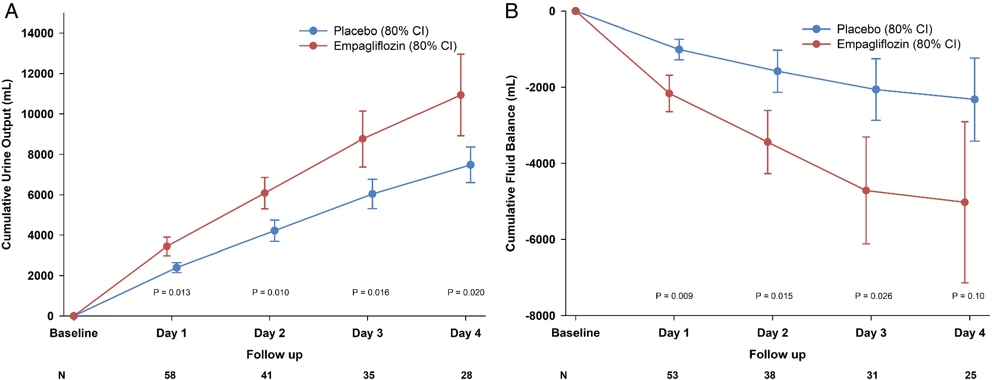
EMPA-RESPONSE-AHF¹⁴
80 patient pilot study
Patients with or without T2DM admitted for acute heart failure exacerbation (randomized within 24 hours of hospital presentation)
No difference in primary endpoints: VAS dyspnoea score, diuretic response, length of stay, or change in NT-proBNP
Composite secondary endpoint of n-hospital worsening HF, rehospitalization for HF or all-cause death occurred in 4 patients with empagliflozin and 13 patients with placebo (P=0.014)
Urinary output was significantly greater with empagliflozin vs placebo (difference 3449 (95% confidence interval 578–6321) mL; P < 0.01)
Notes:
https://www.acc.org/latest-in-cardiology/clinical-trials/2021/11/12/00/29/empulse
https://onlinelibrary-wiley-com.proxy.lib.uiowa.edu/doi/10.1002/ejhf.1713

Slide 28
EMPULSE15
Preliminary results announced at AHA 2021
Patients admitted for HF exacerbation regardless of EF or T2DM status
Primary outcome: composite of death, number of heart failure events, time to first heart failure event, and change in Kansas City Cardiomyopathy Questionnaire-Total Symptom Score (KCCQ-TSS) from baseline to 90 days
Clinical benefit with empagliflozin 53.9% vs 39.7% (p=0.0054)
Secondary outcomes:
Death: 4.2% in the empagliflozin group vs. 8.3% in the placebo group
Heart failure event: 10.6% in the empagliflozin group vs. 14.7% in the placebo group
Change in KCCQ-TSS: 4.5 points for the empagliflozin group vs. the placebo group (p = 0.035)
Acute renal failure: 7.7% in the empagliflozin group vs. 12.1% in the placebo group
Body weight change: -1.5 kg for the empagliflozin group vs. the placebo group (p = 0.014)
Notes:
DOI: 10.1056/NEJMoa2022190

Slide 29
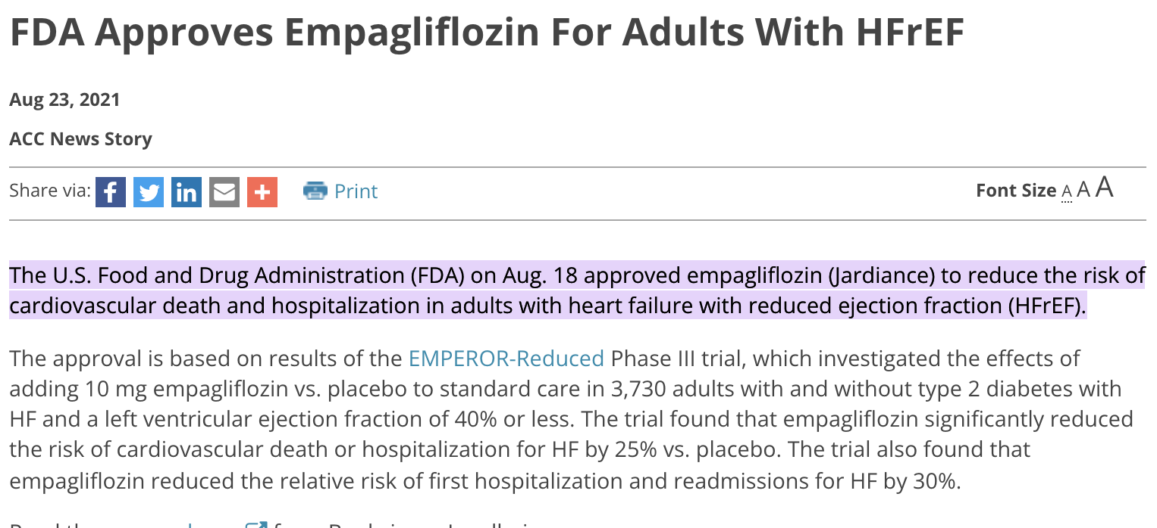

Slide 30
2021 Update to the 2017 ACC Expert Consensus Decision Pathway for Optimization of Heart Failure Treatment⁵
Indications for Use of and SGLT2 Inhibitor
HFrEF (EF </= 40%) with or without diabetes
NYHA class II-IV
Administered in conjunction with a background of guideline-directed medical therapy for heart failure
Max doses of other drugs not required before starting SGLT2
Notes:
https://www.jacc.org/doi/10.1016/j.jacc.2020.11.022

Slide 31
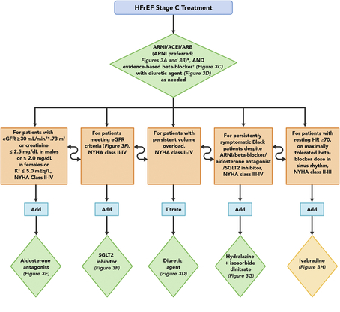
ACC Guidance⁵
Notes:
https://www.jacc.org/doi/10.1016/j.jacc.2020.11.022

Slide 32
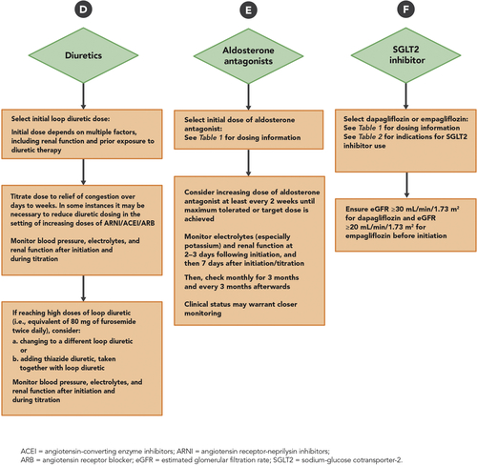
ACC Guidance⁵

Slide 33
SGLT2 Dosing in HF⁵
Dapagliflozin – 10 mg daily
Empagliflozin – 10 mg daily
For HF, caution with
Dapagliflozin eGFR <30 mL/min/1.73m2
Empagliflozin eGFR <20 mL/min/1.73 m2 (based in EMPEROR-Reduced trial)
Notes:
https://www.jacc.org/doi/10.1016/j.jacc.2020.11.022

Slide 34
DPP4s and GLP1s
Saxagliptin showed increased hospitalization rate in HF in cardiovascular trials⁵
3.5% vs. 2.8%; hazard ratio, 1.27; 95% CI, 1.07 to 1.51
Trials of Alogliptin, Sitagliptin, and Linagliptin have not shown increased risk⁵
GLP1s have not demonstrated increased risk in HF in clinical trials⁵

Slide 35
Heart Failure Contraindications
Thiazolidinediones⁵
Associated with edema, water retention, weight gain
Rosiglitazone – in meta-analysis
Increased risk of MI (n = 94/6421 vs 83/7870; RR, 1.42; 95% confidence interval [CI], 1.06-1.91)
Increased risk of heart failure (n = 102/6421 vs 62/7870; RR, 2.09; 95% CI, 1.52-2.88)
Pioglitazone – in meta-analysis
Increased rate of heart failure vs placebo (2.3% vs 1.8%, HR, 1.41; 95% CI, 1.14-1.76)
Reduced risk of composite of death, MI, or stroke (4.4% vs 5.7%, hazard ratio [HR], 0.82; 95% confidence interval [CI], 0.72-0.94)
Metformin⁵
Previously contraindicated in HF on labeling for lactic acidosis
Labeling removed in 2006
Notes:
doi: 10.1001/jama.298.10.1180.
DOI: 10.1001/jama.298.10.1180
https://diabetesjournals-org.proxy.lib.uiowa.edu/care/article/30/12/e129/28105/Metformin-in-Heart-Failure

Slide 36
ADA Guidelines²

Slide 37
Renal

Slide 38
Renal
37% of adults with diabetes have chronic kidney disease¹
Over half have moderate-severe CKD (stage 3-4)
Notes:
https://www.cdc.gov/diabetes/pdfs/data/statistics/national-diabetes-statistics-report.pdf

Slide 39
SGLT2
Many cardiovascular trials also demonstrated renal benefit in secondary outcomes
EMPA-REG, CANVAS, DECLARE
Numerous primary renal trials have also been conducted

Slide 40
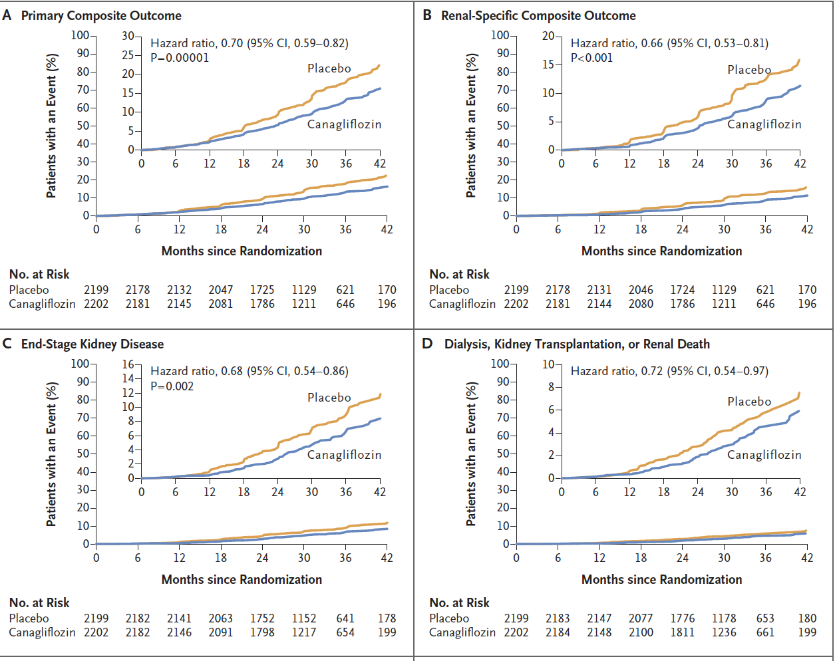
CREDENCE (2019)¹⁸
Canagliflozin vs placebo in T2DM with albuminuric CKD
Primary outcome: composite of end-stage kidney disease, doubling of serum creatinine, or death from renal or cardiovascular causes
Trial ended early due to benefits (median follow-up 2.62 years)
Event rate of primary outcome significantly reduced in canagliflozin group vs placebo (43.2 vs 61.2 per 1000 patient-years; hazard ratio 0.70 [95% CI 0.59-0.82])
NNT for primary outcome 22 (95% CI 15-38)
Notes:
DOI: 10.1056/NEJMoa1811744

Slide 41
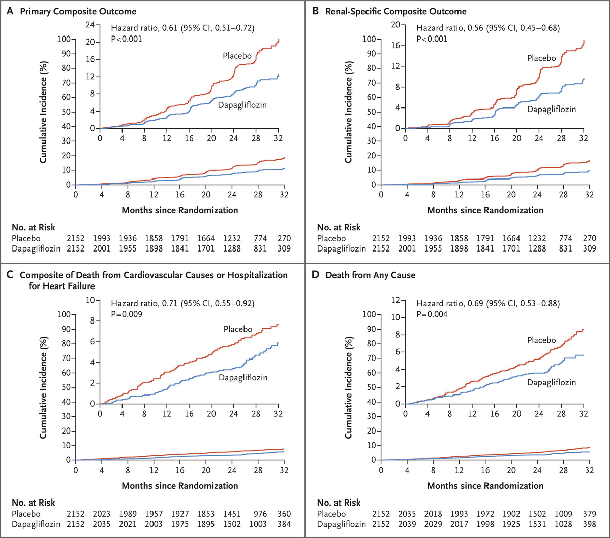
DAPA-CKD (October 2020)¹⁹
Dapagliflozin vs Placebo in patients with CKD (eGFR 25-75) and elevated urine albumin-to-creatinine ratio with or without T2DM
Stable ace or arb for at least 4 weeks
67% of participants with known T2DM (2906 with, 1398 without)
Primary outcome: composite of decline of at least 50% in the estimated GFR, the onset of end-stage kidney disease, or death from renal or cardiovascular causes
Ended early for clear efficacy (median follow-up 2.4 years)
Primary outcome occurred in 9.2% of dapagliflozin and 14.5% of placebo (hazard ratio 0.61, 95% CI 0.51 to 0.72)
Hazard ratio with T2DM 0.64 (95% CI, 0.52 to 0.79)
Hazard ratio without T2DM 0.50 (95% CI, 0.35 to 0.72
Notes:
https://www-nejm-org.proxy.lib.uiowa.edu/doi/10.1056/NEJMoa2024816?url_ver=Z39.88-2003&rfr_id=ori:rid:crossref.org&rfr_dat=cr_pub%20%200pubmed

Slide 42
SGLT2 – Proposed Mechanisms
In mouse models, canagliflozin associated with reduction of angiotensin within the kidney²⁰
Associated with lower blood pressure, renal tubular fibrosis, and renal inflammation
Analysis of blood samples of human patients, canagliflozin was associated with a reduction of several systemic inflammatory biomarkers compared with glimepiride²¹
Notes:
doi:10.1159/000499597
https://doi.org/10.1007/s00125-019-4859-4

Slide 43
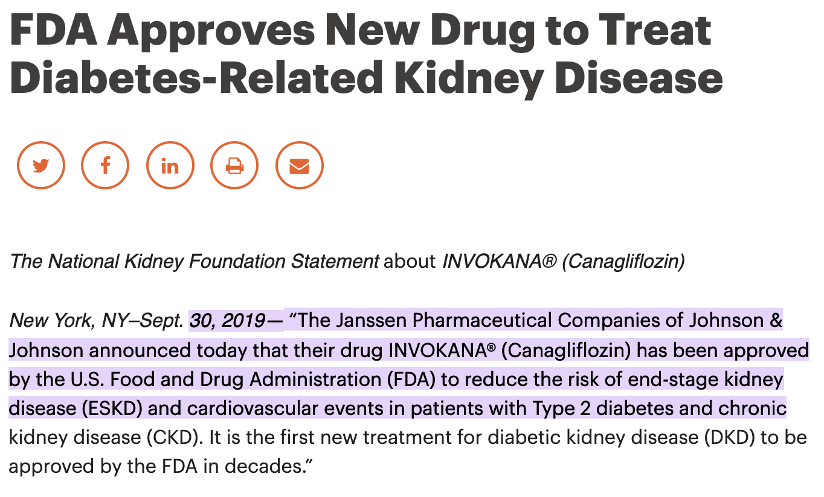
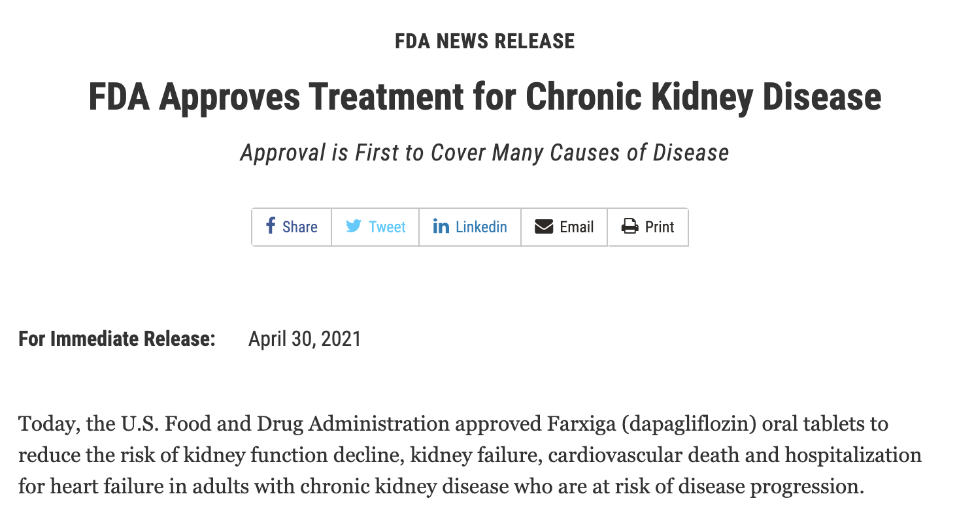

Slide 44
GLP-1 Inhibitors
LEADER (2016)⁹
Lower rate of nephropathy in liraglutide group vs placebo (1.5 vs. 1.9 events per 100 patient-years of observation; hazard ratio, 0.78; 95% CI, 0.67 to 0.92)
SUSTAIN (2016)²⁴
Lower rate of new or worsening nephropathy in semaglutide group vs placebo (3.8% vs 6.1%, hazard ratio, 0.64; 95% CI, 0.46 to 0.88)
FLOW²⁵
Ongoing investigation of semaglutide vs placebo in patients with T2DM and CKD
Estimated completion in 2024
Notes:
https://www-nejm-org.proxy.lib.uiowa.edu/doi/10.1056/NEJMoa1603827?url_ver=Z39.88-2003&rfr_id=ori:rid:crossref.org&rfr_dat=cr_pub%20%200www.ncbi.nlm.nih.gov
https://www-nejm-org.proxy.lib.uiowa.edu/doi/10.1056/NEJMoa1607141?url_ver=Z39.88-2003&rfr_id=ori:rid:crossref.org&rfr_dat=cr_pub%20%200www.ncbi.nlm.nih.gov
https://clinicaltrials.gov/ct2/show/NCT03819153

Slide 45
DPP4
Pooled analysis of 18 phase 2-3 studies of Linagliptin vs placebo²⁶
Primary outcome: new onset of moderate elevation of albuminuria, new onset of severe elevation of albuminuria, reduction in kidney function, halving of estimated glomerular filtration rate, acute renal failure,or death from any cause
Composite outcome occurred in 12.8% of linagliptin and 16% of placebo (HR, 0.84; 95% CI, 0.72-0.97)
Authors conclude that linagliptin not associated with worsening outcomes. Improvement of kidney disease warrants further study
Notes:
http://dx.doi.org/10.1053/j.ajkd.2015.03.024

Slide 46
ADA Guidelines²

Slide 47
Weight Loss

Slide 48
GLP-1 Inhibitors
Liraglutide (Saxenda) FDA approved in 2014 for weight loss²⁷
Max dosing higher than when used for diabetes
3 mg daily vs 1.8 mg daily
Phase 3 trials²⁸
20 weeks: body weight -4.4 kg vs placebo (95% -6.0- to -2.9 kg)
76.1% achieved >/= 5% body weight loss
2 year extended trial: body weight -5.8 kg vs placebo (95% CI: ‐8.0 to ‐3.7 kg)
73% achieved >/= 5% body weight loss
Sales decreased in the US in 2020, but overall increased internationally
Notes:
https://www.accessdata.fda.gov/drugsatfda_docs/nda/2014/206321Orig1s000TOC.cfm
https://www.novonordisk.com/content/dam/nncorp/global/en/investors/irmaterial/quarterly_financial_reports/2020/20210202%20-%20CA%20Q4%202020%20-%20vFINAL.pdf
https://www-ncbi-nlm-nih-gov.proxy.lib.uiowa.edu/pmc/articles/PMC5358074/

Slide 49
GLP-1 Inhibitors
Semaglutide (Wegovy) once weekly for weight loss approved in 2020
STEP Trials²⁹
STEP 1 (published March 2021): Semaglutide 2.4 mg vs Placebo
BMI >/= 30 or >/= 27 with comorbidities; without diabetes
68 week trial
Mean change in body weight -14.9% vs -2.4% with placebo (95% CI −13.4 to −11.5)
Mean body weight -15.3 kg vs -2.6 kg (95% CI -13.7 to – 11.7)
Participants with body weight reduction >/= 5% 86.4% vs 31.5%
50.5% with >/= 15% weight loss
Notes:
https://www-nejm-org.proxy.lib.uiowa.edu/doi/full/10.1056/NEJMoa2032183

Slide 50
GLP-1 Inhibitors
Oral Semaglutide (Rybelsus) – Approved September 2019
Not approved for weight loss
Demonstrated weight reduction in clinical trials (PIONEER Trials)
PIONEER 4 – Oral Semaglutide vs Liraglutide³⁰
Greater weight loss vs liraglutide 1.8 mg
-4.4 kg vs -3.1 kg (95% CI −1·9 to −0·6 kg)
Notes:
https://www-sciencedirect-com.proxy.lib.uiowa.edu/science/article/pii/S0140673619312711?via%3Dihub

Slide 51
SGLT-2 Inhibitors
Average weight loss in diabetic patients (placebo adjusted) with currently approved SGLT2s is 1.5-2 kg³¹
Non-diabetic patients³¹
SGLT2 vs placebo: -1.42 kg, 95% CI: -1.70 to -1.14
BMI: -0.47 kg/m2, 95% CI: -0.63 to -0.31
No significant difference in waist circumference
Notes:
https://link-springer-com.proxy.lib.uiowa.edu/article/10.1007/s40265-019-1057-0
https://www.frontiersin.org/articles/10.3389/fendo.2021.706914/full

Slide 52
ADA Guidelines²
Notes:
https://diabetesjournals.org/view-large/figure/4085296/dc22S009f3.tif

Slide 53
Weight Change Potential of Anti-Diabetic Agents⁸
Notes:
https://diabetesjournals.org/view-large/figure/4085303/dc22S009t1.tif

Slide 54
Summary

Slide 55
Summary
Both SGLT2 and GLP-1 inhibitors have demonstrated cardiovascular benefit for diabetic patients both with clinical ASCVD or at high risk for developing ASCVD
SGLT2 inhibitors have shown benefit for HF both with and without diabetes
SGLT2 inhibitors have demonstrated renal protective benefits both with and without diabetes
GLP-1 inhibitors beneficial for weight loss both with and without diabetes

Slide 56
Notes:
https://diabetesjournals.org/view-large/figure/4085296/dc22S009f3.tif

Slide 57
Notes:
https://diabetesjournals.org/view-large/figure/4085303/dc22S009t1.tif

Slide 58
Questions?

Slide 59
Contact Information
Saidee Oberlander, PharmD, BCPS
Saidee.oberlander@essentiahealth.org

Slide 60
References
1.National Diabetes Statistics Report 2020. Estimates of diabetes and its burden in the United States. Published online 2020:32.
2. American Diabetes Association Professional Practice Committee. 9. Pharmacologic Approaches to Glycemic Treatment: Standards of Medical Care in Diabetes—2022. Diabetes Care. 2022;45(Supplement_1):S125-S143. doi:10.2337/dc22-S009
3.White JR. A Brief History of the Development of Diabetes Medications. Diabetes Spectr. 2014;27(2):82-86. doi:10.2337/diaspect.27.2.82
4. Das SR, Everett BM, Birtcher KK, et al. 2020 Expert Consensus Decision Pathway on Novel Therapies for Cardiovascular Risk Reduction in Patients With Type 2 Diabetes. J Am Coll Cardiol. 2020;76(9):1117-1145. doi:10.1016/j.jacc.2020.05.037
5. Maddox TM, Januzzi JL, Allen LA, et al. 2021 Update to the 2017 ACC Expert Consensus Decision Pathway for Optimization of Heart Failure Treatment: Answers to 10 Pivotal Issues About Heart Failure With Reduced Ejection Fraction. J Am Coll Cardiol. 2021;77(6):772-810. doi:10.1016/j.jacc.2020.11.022
6. Guidance for Industry. Diabetes Mellit. Published online 2008:8.
7. American Diabetes Association Professional Practice Committee. 10. Cardiovascular Disease and Risk Management: Standards of Medical Care in Diabetes—2022. Diabetes Care. 2022;45(Supplement_1):S144-S174. doi:10.2337/dc22-S010
8. Arnott C, Li Q, Kang A, et al. Sodium‐Glucose Cotransporter 2 Inhibition for the Prevention of Cardiovascular Events in Patients With Type 2 Diabetes Mellitus: A Systematic Review and Meta‐Analysis. J Am Heart Assoc. 2020;9(3):e014908. doi:10.1161/JAHA.119.014908
9. Marso SP, Daniels GH, Brown-Frandsen K, et al. Liraglutide and Cardiovascular Outcomes in Type 2 Diabetes. N Engl J Med. 2016;375(4):311-322. doi:10.1056/NEJMoa1603827
10. McMurray JJV, Solomon SD, Inzucchi SE, et al. Dapagliflozin in Patients with Heart Failure and Reduced Ejection Fraction. N Engl J Med. 2019;381(21):1995-2008. doi:10.1056/NEJMoa1911303
11. Packer M, Anker SD, Butler J, et al. Cardiovascular and Renal Outcomes with Empagliflozin in Heart Failure. N Engl J Med. 2020;383(15):1413-1424. doi:10.1056/NEJMoa2022190
12. Anker SD, Butler J, Filippatos G, et al. Empagliflozin in Heart Failure with a Preserved Ejection Fraction. N Engl J Med. 2021;385(16):1451-1461. doi:10.1056/NEJMoa2107038
13. Bhatt DL, Szarek M, Steg PG, et al. Sotagliflozin in Patients with Diabetes and Recent Worsening Heart Failure. N Engl J Med. 2021;384(2):117-128. doi:10.1056/NEJMoa2030183
14. Damman K, Beusekamp JC, Boorsma EM, et al. Randomized, double‐blind, placebo‐controlled, multicentre pilot study on the effects of empagliflozin on clinical outcomes in patients with acute decompensated heart failure (EMPA‐RESPONSE‐AHF). Eur J Heart Fail. 2020;22(4):713-722. doi:10.1002/ejhf.1713
15. Empagliflozin in Patients Hospitalized for Acute Heart Failure. American College of Cardiology. Accessed February 2, 2022. https://www.acc.org/latest-in-cardiology/clinical-trials/2021/11/12/00/29/http%3a%2f%2fwww.acc.org%2flatest-in-cardiology%2fclinical-trials%2f2021%2f11%2f12%2f00%2f29%2fempulse
16. Commissioner O of the. FDA approves new treatment for a type of heart failure. FDA. Published May 22, 2020. Accessed February 2, 2022. https://www.fda.gov/news-events/press-announcements/fda-approves-new-treatment-type-heart-failure

Slide 61
References
17. FDA Approves Empagliflozin For Adults With HFrEF. American College of Cardiology. Accessed February 2, 2022. https://www.acc.org/latest-in-cardiology/articles/2021/08/23/11/39/http%3a%2f%2fwww.acc.org%2flatest-in-cardiology%2farticles%2f2021%2f08%2f23%2f11%2f39%2ffda-approves-empagliflozin-for-adults-with-hfref
18. Perkovic V, Jardine MJ, Neal B, et al. Canagliflozin and Renal Outcomes in Type 2 Diabetes and Nephropathy. N Engl J Med. 2019;380(24):2295-2306. doi:10.1056/NEJMoa1811744
19. Heerspink HJL, Stefánsson BV, Correa-Rotter R, et al. Dapagliflozin in Patients with Chronic Kidney Disease. N Engl J Med. 2020;383(15):1436-1446. doi:10.1056/NEJMoa2024816
20. Woods TC, Satou R, Miyata K, et al. Canagliflozin Prevents Intrarenal Angiotensinogen Augmentation and Mitigates Kidney Injury and Hypertension in Mouse Model of Type 2 Diabetes Mellitus. Am J Nephrol. 2019;49(4):331-342. doi:10.1159/000499597
21. Heerspink HJL, Perco P, Mulder S, et al. Canagliflozin reduces inflammation and fibrosis biomarkers: a potential mechanism of action for beneficial effects of SGLT2 inhibitors in diabetic kidney disease. Diabetologia. 2019;62(7):1154-1166. doi:10.1007/s00125-019-4859-4
22. FDA Approves New Drug to Treat Diabetes-Related Kidney Disease. National Kidney Foundation. Published September 30, 2019. Accessed February 2, 2022. https://www.kidney.org/news/fda-approves-new-drug-to-treat-diabetes-related-kidney-disease
23. Commissioner O of the. FDA Approves Treatment for Chronic Kidney Disease. FDA. Published April 30, 2021. Accessed February 6, 2022. https://www.fda.gov/news-events/press-announcements/fda-approves-treatment-chronic-kidney-disease
24. Marso SP, Bain SC, Consoli A, et al. Semaglutide and Cardiovascular Outcomes in Patients with Type 2 Diabetes. N Engl J Med. 2016;375(19):1834-1844. doi:10.1056/NEJMoa1607141
25. Novo Nordisk A/S. Effect of Semaglutide Versus Placebo on the Progression of Renal Impairment in Subjects With Type 2 Diabetes and Chronic Kidney Disease. clinicaltrials.gov; 2022. Accessed January 31, 2022. https://clinicaltrials.gov/ct2/show/NCT03819153
26. Cooper ME, Perkovic V, McGill JB, et al. Kidney Disease End Points in a Pooled Analysis of Individual Patient–Level Data From a Large Clinical Trials Program of the Dipeptidyl Peptidase 4 Inhibitor Linagliptin in Type 2 Diabetes. Am J Kidney Dis. 2015;66(3):441-449. doi:10.1053/j.ajkd.2015.03.024
27. Saxenda Injection (Liraglutide [rDNA origin]). Accessed February 2, 2022. https://www.accessdata.fda.gov/drugsatfda_docs/nda/2014/206321Orig1s000TOC.cfm
28. Mehta A, Marso SP, Neeland IJ. Liraglutide for weight management: a critical review of the evidence. Obes Sci Pract. 2016;3(1):3-14. doi:10.1002/osp4.84
29. Wilding JPH, Batterham RL, Calanna S, et al. Once-Weekly Semaglutide in Adults with Overweight or Obesity. N Engl J Med. 2021;384(11):989-1002. doi:10.1056/NEJMoa2032183
30. Pratley R, Amod A, Hoff ST, et al. Oral semaglutide versus subcutaneous liraglutide and placebo in type 2 diabetes (PIONEER 4): a randomised, double-blind, phase 3a trial. The Lancet. 2019;394(10192):39-50. doi:10.1016/S0140-6736(19)31271-1
31. Zheng H, Liu M, Li S, et al. Sodium-Glucose Co-Transporter-2 Inhibitors in Non-Diabetic Adults With Overweight or Obesity: A Systematic Review and Meta-Analysis. Front Endocrinol. 2021;12. Accessed February 2, 2022. https://www.frontiersin.org/article/10.3389/fendo.2021.706914
32. American Diabetes Association Professional Practice Committee. 8. Obesity and Weight Management for the Prevention and Treatment of Type 2 Diabetes: Standards of Medical Care in Diabetes—2022. Diabetes Care. 2022;45(Supplement_1):S113-S124. doi:10.2337/dc22-S008

